Slide 1
Reinforcement learning

Slide 2
states
8
environments
9
policies
10
Value functions
11
What is model?
12
Sequential modeling
13
Markov property
14-15
Return and discounted factor
16
MRP
17-18
MDP
19

Slide 3
Bellman expectation (value function)
20
Bellman expectation (action value function)
21
Bellman equation (matrix form)
22
Optimal policy
23-24
Bellman optimality equation
25-26
How to solve bellman equations
27
Dynamic programming
28
Policy evaluation
29-31
Policy improvement
32-32
Policy iteration
34

Slide 4
Generalized policy iteration
35
Value iteration
36-37-38
Asynchrony dynamic programming
39 to 44
Model-based Monte Carlo
45
Model free learning (defining sample and sample efficiency)
From 46
Monte Carlo (policy evaluation)
47-48-49
Incremental mean
50-51
TD learning (policy evaluation)
52-53
Bias and variance trade-off (Monte Carlo and TD)
54
Batch MC and TD
55-56
Back-up diagrams for methods
57

Slide 5
N-step return (policy evaluation)
58-59-60
TD(𝜆) (policy evaluation)
61-62-63-64
Policy improvement (control)
65-66-67
Greedy policy improvement
68
$ε$-Greedy policy improvement
69-70
GLIE
71-72
SARSA learning (on policy)
73-80
Off-policy learning
81-82
Q-learning (off-policy)
83-84-85
Expected-SARSA learning (on policy and off policy)
86
Value function approximation
87-88-89-90
Gradient decent method
91-92

Slide 6
Table look-up method
93
Function approximation (for prediction)
94-95
Function approximation (for control)
96-100
$$batch reinforecement learning$$
101-102
Deep Q network
103
Least square methods (all in once)
104-110
Policy gradient
111-112-113
Policy objective function
114
Ways of solving policy gradient methods
115
Finite difference method (policy gradient)
115

Slide 7
Monte Carlo policy gradient
116-120
Actor critic policy gradient
121-122-123
Reducing variance with Baseline (policy gradient) (defining advantage function)
124-125-126
Simple way for calculating advantage function
127-128
Actor and Critic loss
129
Sparse reward
130
Reward shaping
131
Model-based learning
132-133
Take advantage of models(planning)
134
Dyna-Q
135
Inaccurate models(dyna-Q+)
136

Slide 8
state
agent
information
environment
Environmental state:
All features and parameters by which we define our environment. And we observe these states and pass it to our agent to do some operation on those observations. Environmental states are mostly not fully observable and we only can see part of it (partially observable)
Agent states:
Set of algorithms for mapping our observations to actions
Information states:(MDP)
P$\left(S_{t+1} | S_{t}\right)$=P$\left(S_{t+1} | S_{t}…………….S_{0}\right)$
Future is independent of past given present
$H_{1:T}$→$S_{T}$→$H_{T+1:∞}$
P(𝑆_(𝑡+1)│𝑆_𝑡 )=P(𝑆_(𝑡+1)│𝑆_𝑡…………….𝑆_0 )
Future is independent of past given present
𝐻_(1:𝑇)→𝑆_𝑇→𝐻_(𝑇+1:∞)

Slide 9
Fully observable
In this situation we observe all aspect of environment which satisfy Markov process rule and pass it to agent
$$S_{t}^{env}=S_{t}^{agent}=O_{bs}$$
𝑆_𝑡^𝑒𝑛𝑣=𝑆_𝑡^𝑎𝑔𝑒𝑛𝑡=𝑂_𝑏𝑠
partially observable
In this situation markov process rule is not satisfied so we build our agent state from other ways
1) $S_{t}^{agent}=H_{t}$
1) 𝑆_𝑡^𝑎𝑔𝑒𝑛𝑡=𝐻_𝑡
2) Bayesian rule→$S_{t}^{agent}=(p\left(S_{t}^{agent}=S_{1}\right)…….p(S_{t}^{agent}=S_{n}))$
2) Bayesian rule→𝑆_𝑡^𝑎𝑔𝑒𝑛𝑡=(𝑝(𝑆_𝑡^𝑎𝑔𝑒𝑛𝑡=𝑆_1 )…….𝑝(𝑆_𝑡^𝑎𝑔𝑒𝑛𝑡=𝑆_𝑛))
3) recurrent rule→?

Slide 10
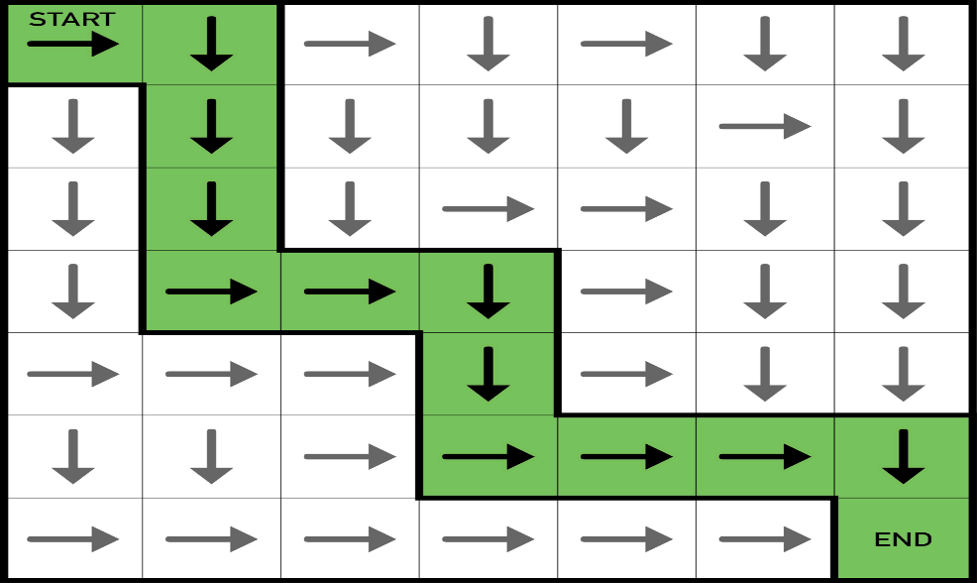
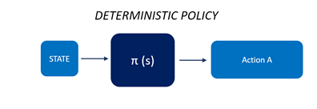
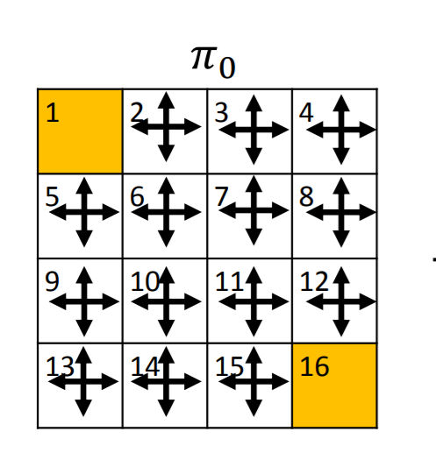
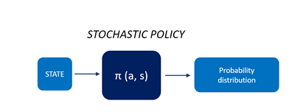
policies
Deterministic policy
Stochastic policy

Slide 11
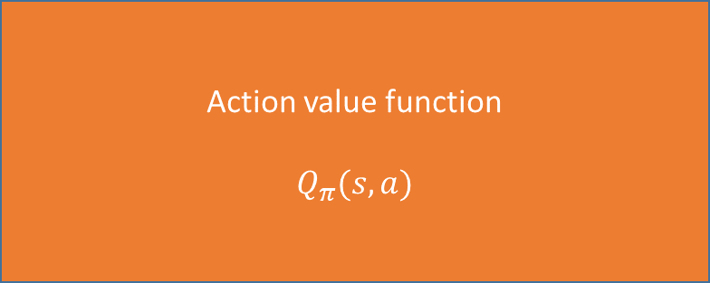
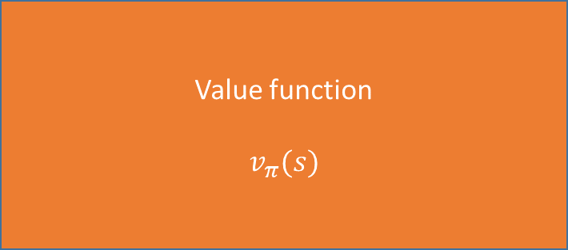
Value function
$$v_{π}(s)$$
Action value function
$$Q_{π}(s,a)$$
How much reward I will get if I follow some specific policy from my current state
How much reward I will get if I follow some specific policy from my current state and taking some specific action
$$v_{π}\left(s\right)=E_{π}[R_{t+1}+γR_{t+1}+γ^{2}R_{t+3}+..|S_{t}=s]$$
$$Q_{π}\left(s,a\right)=E_{π}[R_{t+1}+γR_{t+1}+γ^{2}R_{t+3}+..|S_{t}=s,A_{t}=a]$$

Slide 12
Model: the model predict what environment will do next
Model
$$p_{ss′}^{a}=p\left(s_{t+1}=s′ | s_{t}=s,a_{t}=a\right)$$
𝑝_𝑠𝑠′^𝑎=𝑝(𝑠_(𝑡+1)=𝑠′│𝑠_𝑡=𝑠,𝑎_𝑡=𝑎)
$$R_{s}^{a}=E\left(R_{t+1} | S_{t}=s,A_{t}=a\right)$$
𝑅_𝑠^𝑎=𝐸(𝑅_(𝑡+1)│𝑆_𝑡=𝑠,𝐴_𝑡=𝑎)
When reward function and transition function doesn't change through time
environment is stationary

Slide 13
Rewards
(credit assignment problem)
Chosen path
Reward = z
end
Reward = y
Return = x + y + z
Reward = x
start
We only have return
We don’t have x,y,z
Credit assignment : to what extent x & y & z each contributed in return

Slide 14
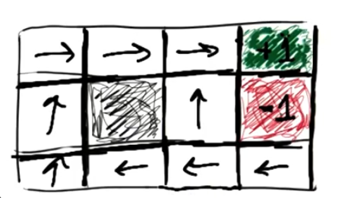
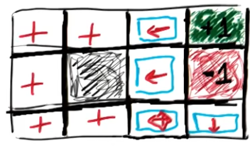
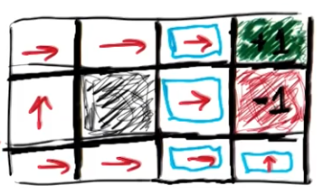
Reward effect
No diff
Reward -0.04 to each move
Reward 2 to each move
Reward -2 to each move
Wants end game but take longer path to get high reward
Wants stay in game as long as possible
Wants end game soon

Slide 15

Return and Discounted Factor
Return: total discounted reward from time step t
$$G_{t}=R_{t+1}+{γR}_{t+2}+…=\sum_{k=0}^{∞}{γ^{k}R_{t+k+1}}$$
$$γ∈\left[0,1\right]$$
𝛾∈[0,1]
$γ$=0 we only care about immediate reward
𝛾=0 we only care about immediate reward
$γ$=1 we care about all feature rewards only when sequence terminates we can use this
𝛾=1 we care about all feature rewards only when sequence terminates we can use this
$0<γ$<1 we care about feature but with discounted factor
0<𝛾<1 we care about feature but with discounted factor

Slide 16
Are data efficient
Effects of discounted rewards
in most of problems discounted factor or gamma should be very high for converging to good policy
When we use discounted rewards
Is not data efficient
High discounted factor means slow learning because of high reward gains
We can use episode reward without considering discounted
rewards and average episodes rewards

Slide 17
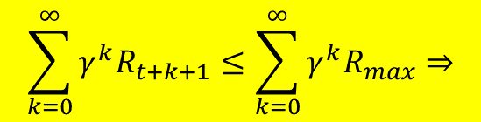
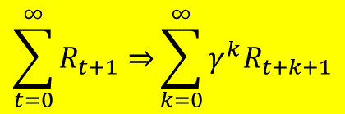
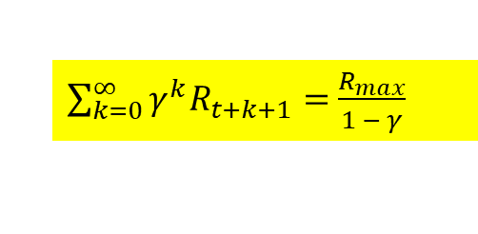
Rules of reinforcement problem
Infinite horizons
Mean episode limit should be infinite
Decision we are making will be different with when horizon is infinite
If not
It is not possible
Introduce discounted rewards
How to solve
$$\sum_{t=0}^{∞}{R_{t+1}⇒}\sum_{k=0}^{∞}{γ^{k}R_{t+k+1}}$$
$$\sum_{k=0}^{∞}{γ^{k}R_{t+k+1}}≤\sum_{k=0}^{∞}{γ^{k}R_{max}⇒}$$
$\sum_{k=0}^{∞}{γ^{k}R_{t+k+1}}=$ $\frac{R_{max}}{1 − γ}$
From Geometric Series

Slide 18
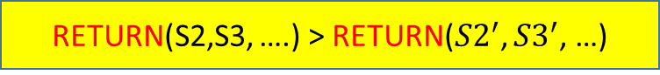
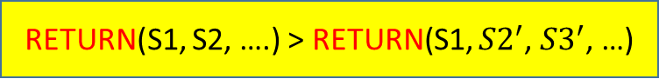
Rules of reinforcement problem
Utility of sequence
RETURN(S1, S2, ….) > RETURN(S1, ${S2}^{′}$, ${S3}^{′}$, …)
RETURN(S2,S3, ….) > RETURN(${S2}^{′}$, ${S3}^{′}$, …)
Greater than
If return for one sequence of states
Return other sequence of states
Greater than
Return for that sequence of states one step ahead
Return other sequence of states one step ahead

Slide 19
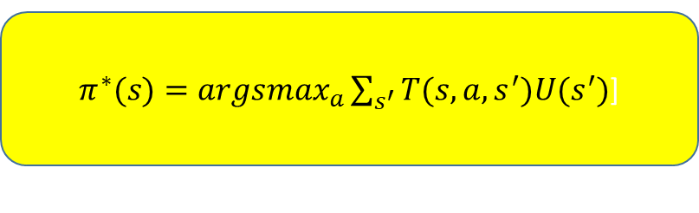
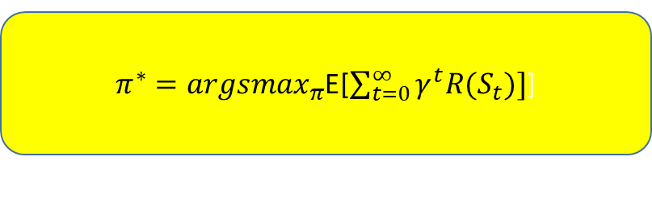
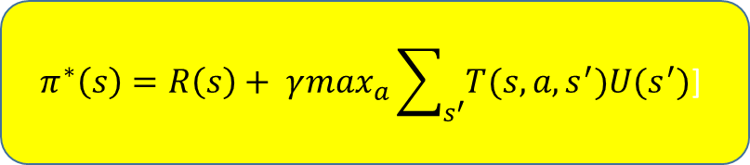
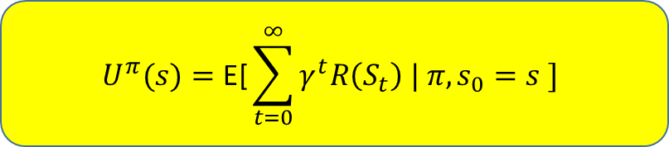
$π^{∗}={argsmax}_{π}$E[$\sum_{t=0}^{∞}{γ^{t}R(S_{t})]}$]
With expectation
policy
$π^{∗}(s)={argsmax}_{a}\sum_{s^{′}}{T(s,a,}s^{′})U(s^{′})$]
Without expectation
$$U^{π}(s)=\text{E}\text{[}\sum_{t=0}^{∞}{γ^{t}R\left(S_{t}\right) | π, s_{0}=s ]}$$
With expectation
Value of state
$$π^{∗}\left(s\right)=R\left(s\right)+ γ\max_{a}\sum_{s^{′}}{T(s,a,}s^{′})U(s^{′})\text{]}$$
Without expectation
Bellman equation

Slide 20
Sequential Decision Making
Planning:
Model is known
Agent perform computation with its model
Agent improve policy
Reinforcement learning:
Model is unknown
Agent interact with environment
Agent improve it’s policy

Slide 21
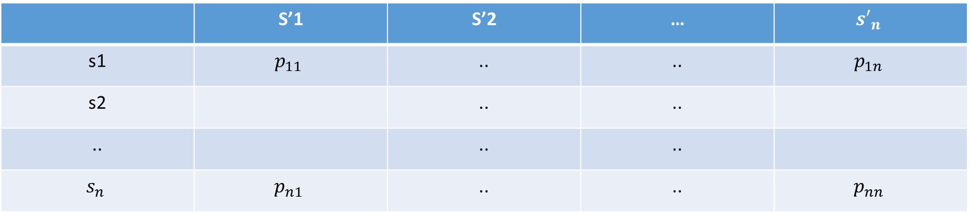
Markov property
Feature is independent of past, given present:
P$\left(S_{t+1} | S_{t}\right)$=P$\left(S_{t+1} | S_{t}…………….S_{0}\right)$
P(𝑆_(𝑡+1)│𝑆_𝑡 )=P(𝑆_(𝑡+1)│𝑆_𝑡…………….𝑆_0 )
Once state is known history can be thrown away
State-transition probability:
$$p_{ss′}=p\left(s_{t+1}=s′ | s_{t}=s\right)$$
𝑝_𝑠𝑠′=𝑝(𝑠_(𝑡+1)=𝑠′│𝑠_𝑡=𝑠)
 | S’1 | S’2 | … | $${s′}_{n}$$
s1 | $$p_{11}$$ | .. | .. | $$p_{1n}$$
s2 |  | .. | ..
.. |  | .. | ..
$$s_{n}$$ | $$p_{n1}$$ | .. | .. | $$p_{nn}$$

Slide 22
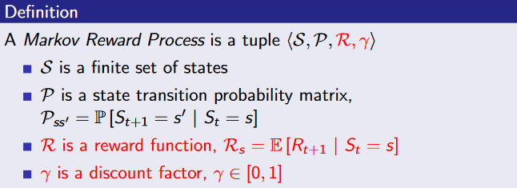
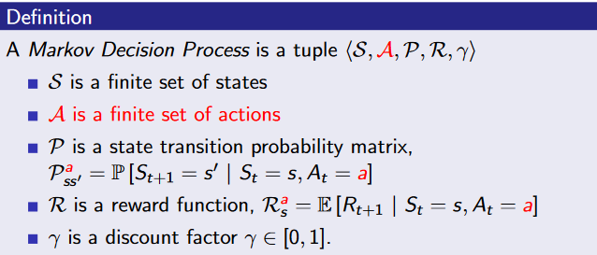
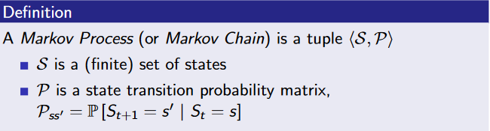
Markov reward process
Markov process
Markov decision process

Slide 23
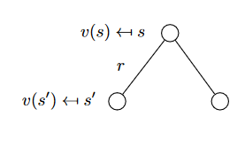
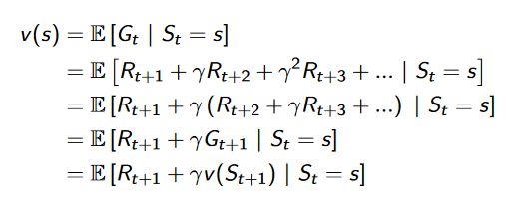
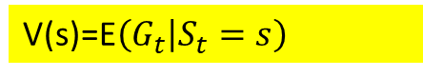
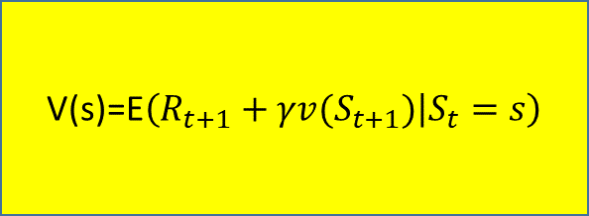
MRP
Value function
V(s)=E$\left(G_{t} | S_{t}=s\right)$
V(s)=$P_{ss^{′}}R_{s}^{a}+γ\sum_{s′εS}{P_{ss^{′}}V(s^{′})}$
V(s)=𝑃_(𝑠𝑠^′ ) 𝑅_𝑠^𝑎+𝛾∑2_𝑠′𝜖𝑆▒〖𝑃_(𝑠𝑠^′ ) 𝑉(𝑠^′)〗
V(s)=$R_{s}+γ\sum_{s′εS}{P_{ss^{′}}V(s^{′})}$
V(s)=𝑅_𝑠+𝛾∑2_𝑠′𝜖𝑆▒〖𝑃_(𝑠𝑠^′ ) 𝑉(𝑠^′)〗
Bellman equation
V(s)=E$\left(R_{t+1}+γv(S_{t+1}) | S_{t}=s\right)$

Slide 24
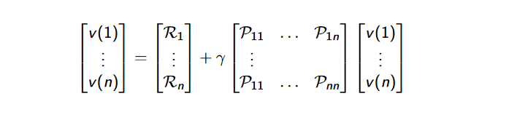
MRP
Bellman Equation Matrix Form
V=$R$+$γρV$
V=𝑅+𝛾𝜌𝑉
V=R+$γPV→\left(1−γP\right)V=R→V={(1−γP)}^{−1}R$
We should solve large MRP with iterative methods

Slide 25

MDP
MRP+Actions
We have actions so we should define policies
$$π\left(a | s\right)=P\left(A_{t}=a | S_{t}=s\right)$$
Policies are stationary
(time-independent)
$$P_{ss′}^{π}=\sum_{a∈A}{π\left(a | s\right)P_{ss′}^{a}}$$
𝑃_𝑠𝑠′^𝜋=∑_(𝑎∈𝐴)▒〖𝜋(𝑎│𝑠) 𝑃_𝑠𝑠′^𝑎 〗
$$R_{s}^{π}=\sum_{a∈A}{π\left(a | s\right)R_{s}}$$
𝑅_𝑠^𝜋=∑_(𝑎∈𝐴)▒〖𝜋(𝑎│𝑠) 𝑅_𝑠 〗
We rewrite our model with respect to policy
$$v_{π}(s)=E_{π}\left(G_{t} | S_{t}=s\right)$$
𝑣_𝜋 (𝑠)=𝐸_𝜋 (𝐺_𝑡│𝑆_𝑡=𝑠)
$$Q_{π}(s,a)=E_{π}\left(G_{t} | S_{t}=s,A_{t}=a\right)$$
𝑄_𝜋 (𝑠,𝑎)=𝐸_𝜋 (𝐺_𝑡│𝑆_𝑡=𝑠,𝐴_𝑡=𝑎)
Bellman equations
$$v_{π}(s)=E_{π}\left(R_{t+1}+γv_{π}(S_{t+1)}) | S_{t}=s\right)$$
𝑣_𝜋 (𝑠)=𝐸_𝜋 (𝑅_(𝑡+1)+𝛾𝑣_𝜋 (𝑆_(𝑡+1)))│𝑆_𝑡=𝑠)
$$Q_{π}(s,a)=E_{π}\left(R_{t+1}+γQ_{π}(S_{t+1},A_{t+1}) | S_{t}=s,A_{t}=a\right)$$
𝑄_𝜋 (𝑠,𝑎)=𝐸_𝜋 (𝑅_(𝑡+1)+𝛾𝑄_𝜋 (𝑆_(𝑡+1),𝐴_(𝑡+1))│𝑆_𝑡=𝑠,𝐴_𝑡=𝑎)

Slide 26
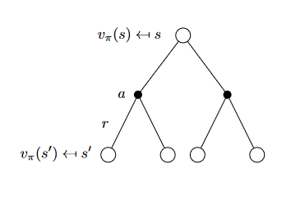
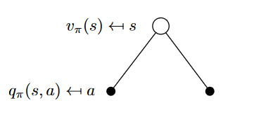
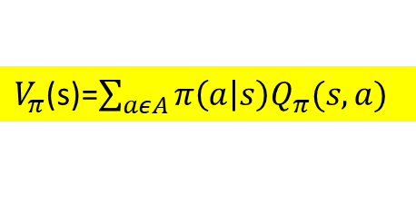
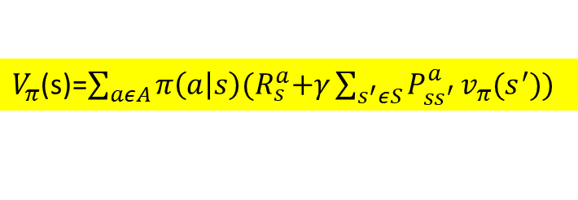
Bellman expectation equation (value-function)
$V_{π}$(s)=$\sum_{aεA}{π\left(a | s\right)Q_{π}(s,a)}$
Bellman expectation equation for value function
$V_{π}$(s)=$\sum_{aεA}{π\left(a | s\right){(R}_{s}^{a}+γ\sum_{s^{′}εS}{P_{ss^{′}}^{a}}v_{π}(s^{′})\text{)} }$

Slide 27
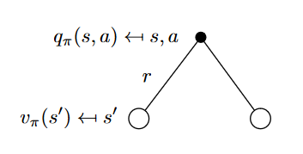
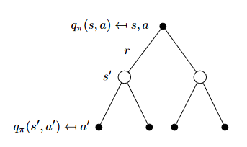
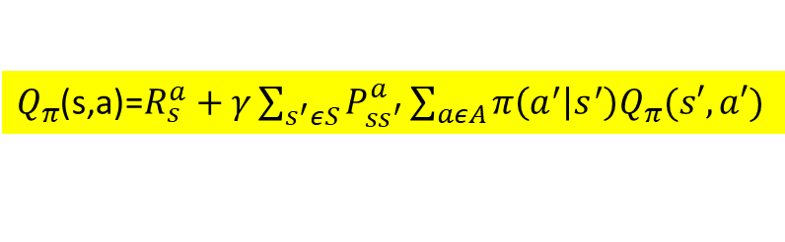
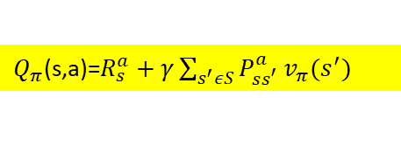
Bellman expectation equation (action_value-function)
$Q_{π}$(s,a)=$R_{s}^{a}+γ\sum_{s^{′}εS}{P_{ss^{′}}^{a}}v_{π}(s^{′})$
Bellman expectation equation for action-value function
$Q_{π}$(s,a)=$R_{s}^{a}+γ\sum_{s^{′}εS}{P_{ss^{′}}^{a}}\sum_{aεA}{π\left(a^{′} | s^{′}\right)Q_{π}(s′,a′)}$

Slide 28


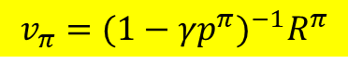
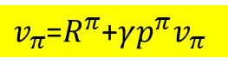
Matrix Form For Solving Bellman Expectation Equation
$$P_{ss′}^{π}=\sum_{a∈A}{π\left(a | s\right)P_{ss′}^{a}}$$
$v_{π}$=$R^{π}$+$γp^{π}v_{π}$
$$R_{s}^{π}=\sum_{a∈A}{π\left(a | s\right)R_{s}}$$
$$v_{π}={(1−γp^{π})}^{−1}R^{π}$$

Slide 29
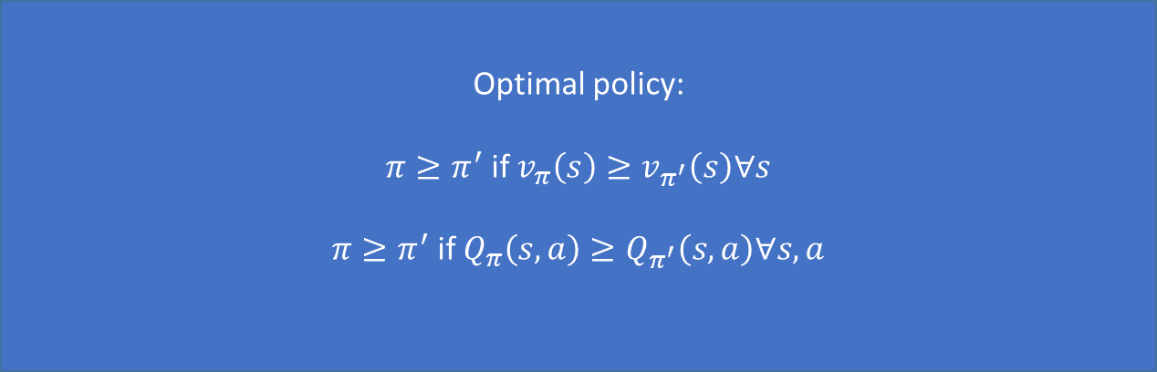
Optimal policy
Optimal policy:
$π≥π^{′}$ if $v_{π}\left(s\right)≥v_{π^{′}}\left(s\right)∀s$
$π≥π^{′}$ if $Q_{π}\left(s,a\right)≥Q_{π^{′}}\left(s,a\right)∀s,a$
$$Q_{∗}\left(s,a\right)=\max_{π}{Q_{π}\left(s,a\right)}$$
𝑄_∗ (𝑠,𝑎)=max┬𝜋⁡〖𝑄_𝜋 (𝑠,𝑎)〗
$$v_{∗}\left(s\right)=\max_{π}{v_{π}\left(s\right)}$$
𝑣_∗ (𝑠)=max┬𝜋⁡〖𝑣_𝜋 (𝑠)〗

Slide 30
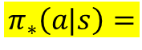
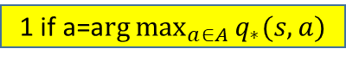
How to find optimal policy
If we could find $Q_{∗}\left(s,a\right) then we can easily find optimal policy$
1 if a=a$rg\max_{a∈A}{q_{∗}(s,a)}$
$$π_{∗}\left(a|s\right)=$$
0 otherwise
There is always one deterministic optimal policy for any MDP

Slide 31
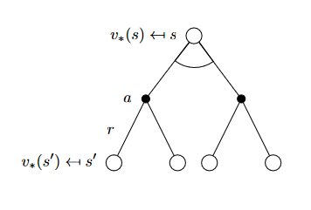
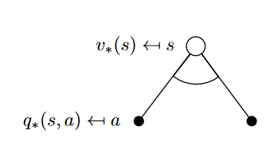
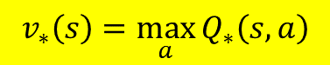
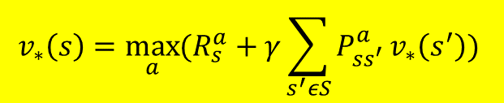
Bellman equations for optimality
$$v_{∗}\left(s\right)=\max_{a}{Q_{∗}\left(s,a\right)}$$
$$v_{∗}\left(s\right)=\max_{a}{(R_{s}^{a}+γ\sum_{s^{′}εS}{P_{ss^{′}}^{a}}v_{∗}\left(s^{′}\right)) }$$
Bellman optimality equation (value_function)

Slide 32
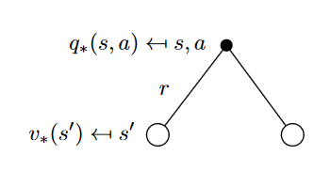
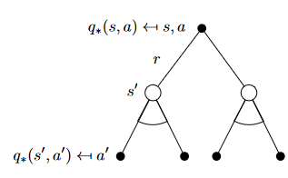
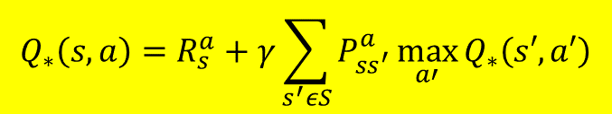
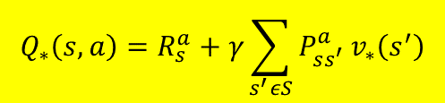
Bellman equations for optimality
$$Q_{∗}\left(s,a\right)=R_{s}^{a}+γ\sum_{s^{′}εS}{P_{ss^{′}}^{a}}v_{∗}\left(s^{′}\right)$$
$$Q_{∗}\left(s,a\right)=R_{s}^{a}+γ\sum_{s^{′}εS}{P_{ss^{′}}^{a}}\max_{a′}{Q_{∗}\left(s′,a′\right)}$$
Bellman optimality equation (action_value function)

Slide 33
How to solve bellman optimality equation
SARSA
Q-learning
Value iteration
Policy iteration

Slide 34
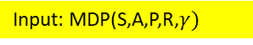
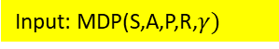
Dynamic: Sequential or temporal component to problem
Dynamic programming
Programming: Optimizing policy
We can apply dynamic programming to problems which have two properties:
Optimal solution can be decomposed to Subperoblems
Subperoblems overlap so solution can be stored and reused
MDP satisfy both properties
Bellman equation give recursive decomposition
Value function store and reuse solutions
Input: MDP(S,A,P,R,$γ)$
Input: MDP(S,A,P,R,$γ)$
Use full knowledge of MDP
prediction
control
We should have model
planning
output: Value function
output: optimal Value- function and optimal policy
P and R

Slide 35





Policy Evaluation (prediction value-function)
We have some specific policy $π$
We have some specific policy 𝜋
we initialize our value function for all state (mostly zero)
$$v_{k=1}\left(s\right)=0 ∀s∈S$$
k --> which iteration we are
𝑣_(𝑘=1) (𝑠)=0 ∀𝑠∈𝑆
k --> which iteration we are
synchronous
We apply bellman expectation equation to all state in every iteration (sweep) and
Update our value functions of every state by using it’s adjacent state’s value functions from previous iteration
$v_{k+1}$(s)=$\sum_{aεA}{π\left(a | s\right){(R}_{s}^{a}+γ\sum_{s^{′}εS}{P_{ss^{′}}^{a}}v_{k}(s^{′})\text{)} }$
$v_{1}$→$v_{2}$→$v_{3}$→..→$v_{π}$ $∀s∈S$
$$P_{ss′}^{π}=\sum_{a∈A}{π\left(a | s\right)P_{ss′}^{a}}$$
$$v^{k+1}=R^{π}+γp^{π}v^{k}$$
Matrix form
We can do this part by linear algebra
$$R_{s}^{π}=\sum_{a∈A}{π\left(a | s\right)R_{s}}$$

Slide 36




Policy Evaluation (prediction Action-Value function)
We have some specific policy $π$
We have some specific policy 𝜋
we initialize our value function for all state (mostly zero)
$$Q_{k=1}\left(s,a\right)=0 ∀s∈S and ∀a∈A$$
k --> which iteration we are
𝑄_(𝑘=1) (𝑠,𝑎)=0 ∀𝑠∈𝑆 𝑎𝑛𝑑 ∀𝑎∈𝐴
k --> which iteration we are
synchronous
We apply bellman expectation equation to all state in every iteration (sweep) and
Update our value functions of every state by using it’s adjacent state’s value functions from previous iteration
$Q_{π}$(s,a)=$R_{s}^{a}+γ\sum_{s^{′}εS}{P_{ss^{′}}^{a}}\sum_{aεA}{π\left(a^{′} | s^{′}\right)Q_{π}(s′,a′)}$
$Q_{1}$→$Q_{2}$→$Q_{3}$→..→$Q_{π}$ $∀s∈S and ∀a∈A$
$$P_{ss′}^{π}=\sum_{a∈A}{π\left(a | s\right)P_{ss′}^{a}}$$
$$Q^{k+1}=R^{π}+γp^{π}Q^{k}$$
Matrix form
We can do this part by linear algebra
$$R_{s}^{π}=\sum_{a∈A}{π\left(a | s\right)R_{s}}$$

Slide 37


Example for policy iteration (synchronous)

Slide 38





Policy improvement (control)
After we find true value functions for given policy, we improve our policy by acting greedy (for now) (later we will see $ε−greedy)$
After we find true value functions for given policy, we improve our policy by acting greedy (for now) (later we will see 𝜀−𝑔𝑟𝑒𝑒𝑑𝑦)
$$π^{′}(s)=greedy\left(v_{π}\right) ∀s∈S$$
$$π^{′}\left(s\right)=arg\max_{aεA}{Q_{π}(s,a)}$$
How it is work?
We assume that we have deterministic policy
a=$π(s)$
We want to make new deterministic policy $π^{′}$ which is better than $π$
$$π^{′}\left(s\right)=arg\max_{aεA}{Q_{π}(s,a)}$$
We take action with respect to new policy $π^{′}$ and for rest we follow previous policy $π$
We take action with respect to new policy 𝜋^′ and for rest we follow previous policy 𝜋
$Q_{π}$(s,$π^{′}(s))=\max_{aεA}{Q_{π}(s,a)}$
𝑄_𝜋(s,𝜋^′ (𝑠))=max┬𝑎𝜖𝐴⁡〖𝑄_𝜋 (𝑠,𝑎)〗

Slide 39




$Q_{π}$(s,$π^{′}(s))=\max_{aεA}{Q_{π}(s,a)}$
𝑄_𝜋(s,𝜋^′ (𝑠))=max┬𝑎𝜖𝐴⁡〖𝑄_𝜋 (𝑠,𝑎)〗
$$\max_{aεA}{Q_{π}(s,a)}≥Q_{π}(s,π(s))$$
$Q_{π}$(s,$π^{′}(s))≥v_{π}(s)$
We have deterministic policy
$$Q_{π}\left(s,π\left(s\right)\right)=v_{π}(s)$$
$$v_{π^{′}}(s)≥v_{π}(s)$$
𝑣_(𝜋^′ ) (𝑠)≥𝑣_𝜋 (𝑠)
When →$Q_{π}$(s,$π^{′}(s))=\max_{aεA}{Q_{π}\left(s,a\right)=Q_{π}\left(s,π\left(s\right)\right) =v_{π}\left(s\right) }$→we stop improvement
When →𝑄_𝜋(s,𝜋^′ (𝑠))=max┬𝑎𝜖𝐴⁡〖𝑄_𝜋 (𝑠,𝑎)=𝑄_𝜋 (𝑠,𝜋(𝑠))" " =𝑣_𝜋 (𝑠)" " 〗→we stop improvement
bellman optimality equation has satisfied→$v_{π}\left(s\right)=\max_{a}{Q_{π}\left(s,a\right)}$
bellman optimality equation has satisfied→𝑣_𝜋 (𝑠)=max┬𝑎⁡〖𝑄_𝜋 (𝑠,𝑎)〗
$v_{π}\left(s\right)$=$v_{∗}\left(s\right)$
𝑣_𝜋 (𝑠)=𝑣_∗ (𝑠)

Slide 40


Policy iteration
By doing evaluation and control steps again and again in a loop we can reach optimal policy

Slide 41

Generalized policy iteration
policy evaluation step iterate through (k) until reach some true value function for specific policy but in this case, we iterate only a few (k)
If k>1 then we actually apply generalized policy iteration
If k=1 our policy iteration process is very similar to value iteration process but with one difference of having policy in Generalized policy iteration

Slide 42



Value Iteration
So we apply bellman optimality equation for all states in each iteration (k)
$$v_{k+1}\left(s\right)=\max_{a}{(R_{s}^{a}+γ\sum_{s^{′}εS}{P_{ss^{′}}^{a}}v_{k}\left(s^{′}\right)) ∀s∈S}$$
𝑣_(𝑘+1) (𝑠)=max┬𝑎⁡〖(𝑅_𝑠^𝑎+𝛾∑_(𝑠^′ 𝜖𝑆)▒𝑃_(𝑠𝑠^′)^𝑎 𝑣_𝑘 (𝑠^′ ))" " ∀𝑠∈𝑆〗
In this process we don’t have any policy but we want to find optimal one
SYNCHRONOUS
$v_{1}$→$v_{2}$→$v_{3}$→..→$v_{∗}$ $∀s∈S$
Intermediate value functions may not correspond to any policy
We can solve this equation by linear algebra
$$v_{k+1}=\max_{a∈A}{R^{a}}+γP^{a}v_{k}$$

Slide 43


Value Iteration
So we apply bellman optimality equation for all states in each iteration (k)
$$Q_{k+1}\left(s,a\right)=R_{s}^{a}+γ\sum_{s^{′}εS}{P_{ss^{′}}^{a}}\max_{a′}{Q_{k}\left(s′,a′\right)}$$
𝑄_(𝑘+1) (𝑠,𝑎)=𝑅_𝑠^𝑎+𝛾∑_(𝑠^′ 𝜖𝑆)▒𝑃_(𝑠𝑠^′)^𝑎 max┬𝑎′⁡〖𝑄_𝑘 (𝑠′,𝑎′)〗
In this process we don’t have any policy but we want to find optimal one
SYNCHRONOUS
$Q_{1}$→$Q_{2}$→$Q_{3}$→..→$Q_{π}$ $∀s∈S and ∀a∈A$
Intermediate value functions may not correspond to any policy
We can solve this equation by linear algebra
$$Q^{k+1}=R^{π}+γp^{π}Q^{k}$$

Slide 44

Value iteration example

Slide 45



Policy iteration vs value iteration
Evaluate current policy k iteration with bellman expectation equation
Start with arbitery policy
Policy iteration
Update policy with maximizing among action for each state
$$π^{′}(s)=greedy\left(v_{π}\right) ∀s∈S$$
Start with arbitrary value function
$$π^{′}\left(s\right)=arg\max_{aεA}{Q_{π}(s,a)}$$
If model is available
Update values until convergence with bellman expectation equation
Value iteration
${π_{k+1}=argsmax}_{a}\sum_{s^{′}}{T(s,a,}s^{′})U_{k} (s^{′})$]

Slide 46


Relation between bellman equations
V(s) = $\max_{a}Q(s,a)$
Q(s,a) =$R\left(s\right)+ γ\sum_{s^{′}}{T(s,a,}s^{′})V(s^{′})\text{]}$

Slide 47
Relation ( policy and value function )
Efficient wrt time and memory
Our main intention
Finding policies not value functions
We pick that value function that easily has Been found
All of those leads to one specific policy (global policy)
It may exist thousands of value function distribution among states

Slide 48
problems | bellman | algorithm
prediction | Expectation equation | Policy evaluation
control | Expectation and greedy policy improvement | Policy iteration
control | Optimality equation | Value iteration
Synchronous dynamic programming algorithms

Slide 49
Asynchronous dynamic programming
In place dynamic programming
Prioritized sweeping
Real-time dynamic programming
In Synchronous method we should sweep through all state in each iteration thus is not time-efficient
Asynchronous method can reduce computation
Asynchronous DP backs up states individually, in any order

Slide 50




In-place dynamic programming
synchronous
asynchronous
$$v_{new}\left(s\right)=\max_{a}{(R_{s}^{a}+γ\sum_{s^{′}εS}{P_{ss^{′}}^{a}}v_{old}\left(s^{′}\right)) }$$
v$\left(s\right)=\max_{a}{(R_{s}^{a}+γ\sum_{s^{′}εS}{P_{ss^{′}}^{a}}v\left(s^{′}\right)) }$
$$v_{old}←v_{new}$$
$$there is no update$$
Stores two copies of value functions (two placeholder)
Stores one copies of value functions (one placeholder)
V-old
V-new
V

Slide 51

Prioritized sweeping
We use some magnitude for deciding which state should be updated
We can use priority queue
For all state we will have this magnitude
$$\max_{a}\left(R_{s}^{a}+γ\sum_{s^{′}εS}{P_{ss^{′}}^{a}}v_{k}\left(s^{′}\right)\right) −v(S)$$
At each update of state we should update error magnitude for that state
We should have knowledge of reverse dynamic

Slide 52



Real time dynamic programming
Now we dive into model free learning
agent
At each time step agent gain some experience
$$S_{t},A_{t},R_{t+1}$$
v$\left(s_{t}\right)=\max_{a}{(R_{s_{t}}^{a}+γ\sum_{s^{′}εS}{P_{s_{t}s^{′}}^{a}}v\left(s^{′}\right)) }$
This equation is for in-place method
We can use place-in
Then we update value function for that state $S_{t}$
We can use synchronous

Slide 53



Model free learning
Use experience for updating value functions
We don’t have model of environment
Monte Carlo method:
(episodic tasks)
Use agent
TD learning
(Continues task)
(bootstrapping)
$$P_{ss′}^{π}=\sum_{a∈A}{π\left(a | s\right)P_{ss′}^{a}}$$
$$R_{s}^{π}=\sum_{a∈A}{π\left(a | s\right)R_{s}}$$
Q-LEARNING
TD(0)
TD($γ)$
SARSA

Slide 54



Model-based Monte Carlo
We don’t have transition and reward
Based on our data
First we take some trajectory
T(s,a,s’)=$\frac{times(s,a,s’) }{times(s,a)}$
get
$s_{1}$, $a_{1}$, $r_{1}$, $s_{2}$, $a_{2}$, $r_{2}$, $s_{3}$
R(s,a,s’)=$r_{1 to n}$
MDP
Policy iteration
value iteration

Slide 55
Model Free Policy Evaluation
Samples
number of actions agent takes and number of states agent visit and rewards it gets during training in order to reach a certain level of performance
Samples effeciency
Sample Efficiency denotes the amount of experience that an agent/algorithm needs to generate in an environment (e.g. the number of actions it takes and number of resulting states + rewards it observes) during training in order to reach a certain level of performance.
point
They don’t use of experiences which they create in their run
Evolution strategies like algorithms are not sample efficient

Slide 56






Policy evaluation
Monte Carlo
Process should be episodic
We have agent
We do this to infinity
We average all $G_{t}$ for every state to find value function
We restart our episode
We have specific policy $π$
Compute return for every state which we have seen through episode and update our values
$$S_{1},A_{1},R_{2},…,S_{K}\sim π$$
$$G_{t}=R_{t+1}+γR_{t+2}+…γ^{T−1} R_{T}$$
We take action according to our policy until reach end of episode
V(s)=E$\left(G_{t} | S_{t}=s\right)$
Q(s,a)=E$\left(G_{t} | S_{t}=s,A_{t}=a\right)$

Slide 57





How we average
Value function
first visit Monte Carlo
every visit Monte Carlo
In every episode when first time we see some specific state like (s)
In every episode when every time we see some specific state like (s)
Counter(s)=Counter(s)+1
Counter(s)=Counter(s)+1
(We could do this many times in one episode)
V(s)→$v_{π}(s)$
We compute $G_{t}=R_{t+1}+γR_{t+2}+…γ^{T−1} R_{T}$
We compute $G_{t}=R_{t+1}+γR_{t+2}+…γ^{T−1} R_{T}$
(We could do this many times in one episode)
Total sum(s)=Total sum(s)+$G_{t}$(s)
We do this loop to counter(s)→$∞$ and get true value function for policy which we make our episodes
We do this loop to counter(s)→∞ and get true value function for policy which we make our episodes
Total sum(s)=Total sum(s)+$G_{t}$(s)+$G_{t}$(s)+..
(just one time)
We average
We average
V(s)=Total sum(s)/counter(s)
V(s)=Total sum(s)/counter(s)

Slide 58

How we average
But we have better method for taking average
Action-Value function
first visit Monte Carlo
every visit Monte Carlo
In every episode when first time we see some specific state and action like (s,a)
In every episode when every time we see some specific state and action like (s,a)
Counter(s)=Counter(s)+1
Counter(s)=Counter(s)+1
(We could do this many times in one episode)
Q(s,a)→$Q_{π}(s,a)$
We compute $G_{t}=R_{t+1}+γR_{t+2}+…γ^{T−1} R_{T}$
We compute $G_{t}=R_{t+1}+γR_{t+2}+…γ^{T−1} R_{T}$
(We could do this many times in one episode)
Total sum(s)=Total sum(s)+$G_{t}$(s)
We do this loop to counter(s)→$∞$ and get true value function for policy which we make our episodes
We do this loop to counter(s)→∞ and get true value function for policy which we make our episodes
Total sum(s)=Total sum(s)+$G_{t}$(s)+$G_{t}$(s)+..
(just one time)
We average
We average
Q(s,a)=Total sum(s)/counter(s)
Q(s)=Total sum(s)/counter(s)

Slide 59


Incremental mean
We can apply this to our Monte Carlo method
$u_{k}$→ mean over k iteration

Slide 60



Incremental Monte Carlo updates
first visit Monte Carlo
every visit Monte Carlo
In every episode when we visit some specific state (s) or state and action (s,a)
In every episode every time when visit some specific state (s) or state and action (s,a)
mostly we use $α \left(learning rate\right)$
Instead of $\frac{1}{counter(S_{t})}$ to forget old episodes
We do update
We do update
$v\left(s\right)←v\left(s\right)+\frac{1}{counter(s)}$($G_{t}−V(s))$
$v\left(s_{t}\right)←v\left(S_{t}\right)+\frac{1}{counter(S_{t})}$($G_{t}−V(S_{t}))$
$Q\left(s,a\right)←Q\left(s,a\right)+\frac{1}{counter(s,a)}$($G_{t}−Q(s,a))$
$Q\left(s_{t},a_{t}\right)←Q\left(s_{t},a_{t}\right)+\frac{1}{counter(S_{t},a_{t})}$($G_{t}−Q(s_{t,}a_{t}))$

Slide 61







Policy evaluation
Temporal difference learning TD(0)
Process doesn't have to be episodic and we can use this method for continues process
(bootstrapping)
We have agent
We do this to infinity
$Q\left(s_{t},a_{t}\right)←Q\left(s_{t},a_{t}\right)+α$($G_{t}−Q(s_{t,}a_{t}))$
We apply incremental method to update our value-function
We have specific policy $π$
$v\left(s_{t}\right)←v\left(S_{t}\right)+α$($G_{t}−V(S_{t}))$
t<-t+1
These are TD targets
Compute return for that state $S_{n}$ by (bootstrapping)
$$G_{t}=R_{t+1}+γv(s_{t+1})$$
We take action according to our policy just one step
$$S_{t},A_{t},R_{t+1},S_{t+1}\sim π$$
$$G_{t}=R_{t+1}+γQ(S_{t+1},A_{t+1})$$
ACTION VALUE FUNCTION WE SHOULD HAVE $A_{t+1} too$

Slide 62

Compression between MC and TD Incremental update
MC method is Offline process
TD method is online process
TD works in continues environment
MC works just in episodic environment
MC not sensitive to initial values
TD sensitive to initial values
We don’t use this in markov decision environment
We use this in markov decision environment
Left) As we can see in MC method after reaching end of episode we update previous value function of all state with respect to that
Right) As we can see in TD method after taking one step we just update previous value function of previous state with respect to our next state value function

Slide 63
Bias and variance trade-off between MC and TD(0)
Since for updating our value-function we go to end of episode and then we update our states value functions
MC
There is no bias
Bias
Since for updating our value-function we don’t go to end of episode and we just go one step forward so we estimate how much reward we will get
TD(0)
We have bias
Since for updating our value-function we go to end of episode so we have some error in each state and we pile up these errors and get variance
Variance
MC
We have variance
Since for updating our value-function we don’t go to end of episode and we just go one step forward so we don’t pile up errors and we won’t have variance
TD(0)
There is no variance

Slide 64


Batch MC and TD
If we have finite experiences or episodes
$$S_{1}^{1},A_{1}^{1},R_{2}^{1},….,S_{T_{1}}^{1}$$
.
.
.
.
$$S_{1}^{K},A_{1}^{K},R_{2}^{K},….,S_{T_{K}}^{K}$$
K=number of episodes
Apply MC or TD(0) to that specific episode→(k)
Sample from episode:
$$k∈[1,K]$$

Slide 65




Example
(Having Finite Experience)
If we use MC →
$$\sum_{k=1}^{K}{\sum_{t=1}^{T_{k}}{{(G_{t}^{k}−V(s_{t}^{k}))}^{2}}}$$
V(A)=0
MC will converges to mean-square error solution
If we use TD(~) →
$$p_{s,s′}^{a}=\frac{1}{N(s,a)}\sum_{k=1}^{K}{\sum_{t=1}^{T_{k}}{1(s_{t}^{k},a_{t}^{k},s_{t+1}^{k} =s,a,s′)}}$$
$$R_{S}^{a}=\frac{1}{N(s,a)}\sum_{k=1}^{K}{\sum_{t=1}^{T_{k}}{1(s_{t}^{k},a_{t}^{k} =s,a)}}$$
V(A)=0.75
TD will converges to maximum like-hood solution

Slide 66



Backups
different methods

Slide 67


n-step prediction
($∞+1 step)$
TD(∞)
Monte Carlo)
(1 step)
TD(0)
(3 step)
TD(2)

Slide 68


N-step returns
$$G_{t}^{n}=R_{t+1}+γR_{t+2}+…+γ^{n−1}R_{t+n}+γ^{n}v(s_{t+n})$$
n=1
$$G_{t}^{1}=R_{t+1}+γv(s_{t+1})$$
n=2
$$G_{t}^{2}=R_{t+1}+γR_{t+2}+γ^{2}v(s_{t+2})$$
N-step update
n=∞
$$G_{t}^{∞}=R_{t+1}+γR_{t+2}+…+γ^{T−1}R_{t}$$
$v\left(s_{t}\right)←v\left(S_{t}\right)+α$($G_{t}^{n}−v(S_{t}))$

Slide 69


Averaging N-step returns
We can average n-step return over different (n)
For combining all information from all time step
$$\frac{1}{2}\left(G^{2}\right)+\frac{1}{2}\left(G^{4}\right)$$
Combine information from two different time step

Slide 70





$$λ return$$
We give weight to each n-step return
$$weigths→(1−λ)λ^{n−1}$$
update
$$G_{t}^{λ}=(1−λ)\sum_{n=1}^{∞}{λ^{n−1}G_{t}^{n}}$$
$v\left(s_{t}\right)←v\left(S_{t}\right)+α$($G_{t}^{λ}−v(S_{t}))$

Slide 71






TD($λ)$ offline or online?
TD($λ$)
Forward view
TD($λ$)
Backward view
Similar to MC
Off-line
On-line
$$G_{t}^{λ}=(1−λ)\sum_{n=1}^{∞}{λ^{n−1}G_{t}^{n}}$$
We wait until end of episode then for each state we find all n-step return and then we use equation for updates
$v\left(s_{t}\right)←v\left(S_{t}\right)+α$($G_{t}^{λ}−v(S_{t})$)

Slide 72







$$γλE_{t−1}\left(s\right) ∀s∈S$$
By passing each time step We decrease eligibility trace all states
time
Two factor has effect on eligibility trace
Increase 1 ($S_{t}=s)$
Whenever we visit some specific state (s) we increase eligibility trace
visiting some specific state
$E_{0}\left(s\right)=0$ $∀s∈S$
At start we give all eligibility traces to all state, zero
Eligibility trace
$E_{t}(s)=γλE_{t−1}\left(s\right)$+1($S_{t}=s)$
Update
V(s)$←$V(s)+$αδ_{t}E_{t}\left(s\right)∀ s$
Find TD error
$${δ_{t}=R}_{t+1}+γv\left(s_{t+1}\right)−v(s_{t})$$
It’s like giving weights to each state
But this weights are not constant and by passing time and visiting specific states changes
We use eligibility traces
Means: how amount some state (or state-action) visited in past has effect on current state (or state-action)

Slide 73




TD(𝜆)
This method add more learning to states that are visited multiple time un episode with eligibility traces
𝜆=0
𝜆=1
𝜆=1
Forward view
backward view
Eligibility trace
$E_{t}(s)=γλE_{t−1}\left(s\right)$+1($S_{t}=s)$
$${ E}_{t}(s)=\text{1}\text{(}S_{t}=s)$$
Update
V(s)$←$V(s)+$αδ_{t}E_{t}(s)$
At each step we update all states value
We wait until end of episode for updating our states values
Eligibility trace
$E_{t}(s)=γλE_{t−1}\left(s\right)$+1($S_{t}=s)$
It’s TD(0)
Similar to MC
TD(1)

Slide 74


TD(1) backward

Slide 75



Slide 76
TD(0) vs TD(1)
TD(1)
TD(0)
TD(1)
Forward view
backward view
Monte carlo
Sample efficient
Monte carlo with eligibility traces
Not sample efficient
Not sample efficient

Slide 77
Model Free Policy control

Slide 78


control
On policy
Off policy
It’s better since we can use other agent experience for updating our policy
Learn about policy $π$from experience sampled from policy $π$
Learn about policy $π$from experience sampled from policy $μ$

Slide 79




How do we improve our policy?
greedy
$$ε−greedy$$
Action-Value function
Value function

Slide 80


Greedy policy improvement
Action-value function
Value function
$$\underset{a∈A}{π^{′}\left(s\right)=argmax}{Q(s,a)}$$
$$\underset{a∈A}{π^{′}\left(s\right)=argmax}{{(R}_{s}^{a}+p_{ss^{′}}^{a}}v(s^{′})$$
We don’t need model
In this case for improvement we need model of environment
in model free policy iterations, we use action-value function to facilitate our policy improvement section

Slide 81






Why do we use $ε−greedy$
We want to ensure find optimal policy
With greedy actions we just search specific (state, action) pairs and may never see state with high values to update
So we use $ε−greedy$
$ε→$with chance of $ε$ $\%$ we choose our actions randomly with uniform distribution to make our experiences
$ε$/m+1- $ε$ probability of choosing maximum value action $a^{∗}= \underset{a∈A}{argmax}{Q(s,a)}$
We choose best action with probability of given value
$ε$-greedy equation
$π$(s|a)=
$ε$/m probability of choosing other actions except maximum value one
It just give uniform distribution over actions
m -> number of action available from specific state

Slide 82


$why ε$-greedy improvement works?

Slide 83




GLIE
First act $ε−greedy$
gradually
Decrease $ε$ value
At the end we will reach optimal greedy policy
When $\lim_{k→∞}{N_{k}\left(s,a\right)=∞} ∀s∈S,∀a∈A$
$$\lim_{k→∞}{π_{k}\left(s|a\right)=1}(a=\underset{a∈A}{argmax}{Q(s,a)})$$

Slide 84




GLIE Monte Carlo
Sample episode k
$$(S_{1},A_{1},R_{2},…,S_{T})\sim π$$
k$←k+1$
counter($s_{t},a_{t}$)=counter($s_{t},a_{t}$)+1
$$ε←\frac{1}{k}$$
𝜀←1/𝑘
$$π←ε_greedy(Q)$$
𝜋←𝜀_𝑔𝑟𝑒𝑒𝑑𝑦(𝑄)
$Q\left(s_{t},a_{t}\right)←Q\left(s_{t},a_{t}\right)+\frac{1}{counter(S_{t})}$($G_{t}−Q(s_{t,}a_{t}))$

Slide 85




TD algorithm
SARSA
We have $(S_{t},A_{t},R_{t+1},S_{t+1},A_{t+1})$
Action-value function
$Q\left(s_{t},a_{t}\right)←Q\left(s_{t},a_{t}\right)+α$($R_{t+1}+γQ(S_{t+1},A_{t+1})−Q(s_{t,}a_{t}))$
(On-policy) SARSA
We have used $ε−greedy although we can use greedy but it is not effecient$

Slide 86


We see that we take action according to policy $ε−greedy$ and evaluate that action according to $ε−greedy$ so it’s on policy
SARSA PSUDOCODE

Slide 87



We use GLIE
Just with 2 condition SARSA convergence to optimal policy
We use variable learning rate instead of counter in GLIE
Learning rate $α_{t}$ should satisfy following conditions
$$\sum_{t=1}^{∞}{α_{t}^{2}<∞}$$
$$\sum_{t=1}^{∞}{α_{t}=∞}$$
Big enough to update as long as we want
Small enough to eventually vanish updates

Slide 88

N-step SARSA
$$G_{t}^{n}=R_{t+1}+γR_{t+2}+…+γ^{n−1}R_{t+n}+γ^{n}v(s_{t+n})$$
n=1
$$G_{t}^{1}=R_{t+1}+γv(s_{t+1})$$
SARSA
n=2
$$G_{t}^{2}=R_{t+1}+γR_{t+2}+γ^{2}v(s_{t+2})$$
N-step SARSA update
n=∞
$$G_{t}^{∞}=R_{t+1}+γR_{t+2}+…+γ^{T−1}R_{t}$$
MC
$Q\left(s_{t},a_{t}\right)←Q\left(s_{t},a_{t}\right)+α$(($G_{t}^{n}−Q(s_{t,}a_{t}))$

Slide 89



CONTROL
$$λ return$$
ACTION-VALUE FUNCTION
We give weight to each n-step return
$$weigths→(1−λ)λ^{n−1}$$
update
$$G_{t}^{λ}=(1−λ)\sum_{n=1}^{∞}{λ^{n−1}G_{t}^{n}}$$
$Q\left(s_{t},a_{t}\right)←Q\left(s_{t},a_{t}\right)+α$(($G_{t}^{λ}−Q(s_{t,}a_{t}))$

Slide 90





SARSA($γ)$ offline or online?
SARSA($λ$)
Forward view
SARSA($λ$)
Backward view
Similar to MC
Off-line
On-line
$$G_{t}^{λ}=(1−λ)\sum_{n=1}^{∞}{λ^{n−1}G_{t}^{n}}$$
We wait until end of episode then for each state we find all n-step return and then we use equation for updates
$Q\left(s_{t},a_{t}\right)←Q\left(s_{t},a_{t}\right)+α$(($G_{t}^{λ}−Q(s_{t,}a_{t}))$

Slide 91






$γλE_{t−1}\left(s,a\right) ∀s∈S$, $∀a∈A$
By passing each time step We decrease eligibility trace all states
time
Two factor has effect on eligibility trace
Increase 1 ($S_{t}=s,A_{t}=a)$
Whenever we visit some specific state (s) we increase eligibility trace
visiting some specific state
Eligibility trace
$E_{t}(s,a)=γλE_{t−1}\left(s,a\right)$+1($S_{t}=s,A_{t}=a)$
$E_{0}\left(s,a\right)=0$ $∀s∈S$, $∀a∈A$
At start we give all eligibility traces to all state, zero
Update
Q(s,a)$←$ Q(s,a)+$αδ_{t}E_{t}(s,a)$
Find TD error
$δ_{t}$=$R_{t+1}+γQ(S_{t+1},A_{t+1})−Q(s_{t,}a_{t}))$
It’s like giving weights to each state
But this weights are not constant and by passing time and visiting specific states changes
$$R_{t+1}+γQ(S_{t+1},A_{t+1})−Q(s_{t,}a_{t}))$$
We use eligibility traces
Means: how amount some state (or state-action) visited in past has effect on current state (or state-action)

Slide 92

SARSA(𝜆) PSUDOCODE

Slide 93




Off-policy
We want expectation from our target policy
Target policy
Evaluate $π\left(s | a\right)$ to reach true values
$v_{π}$(s) and $Q_{π}(s)$
behavior policy
We use this to taking actions and gain experiences (explore the environment)
$$(S_{1},A_{1},R_{2},…,S_{T})\sim μ$$
But we take sample from behavior policies
Use other agent’s observations
Re-use experiences from old policies $π_{1},π_{2},…$
Why we use off-policy
Learn about optimal policy while following exploratory policy
We should adjust equation for tackling this problem
Learn about multiple policies while following one policy

Slide 94




$v\left(s_{t}\right)←v\left(S_{t}\right)+α$($G_{t}^{π/μ}−v(S_{t}))$
$$v\left(s_{t}\right)←v\left(S_{t}\right)+α G_{t}^{π/μ}(R_{t+1}+γv\left(s_{t+1}\right)−v(S_{t}))$$
update
update
$G_{t}^{π/u}=\frac{π\left(A_{t},S_{t}\right)π\left(A_{t+1},S_{t+1}\right)}{u\left(A_{t},S_{t}\right)u\left(A_{t+1},S_{t+1}\right)}$…$\frac{π\left(A_{T},S_{T}\right)}{u\left(A_{T},S_{T}\right)}$
$$G_{t}^{π/u}=\frac{π\left(A_{t},S_{t}\right)}{μ\left(A_{t},S_{t}\right)}$$
(EMPTY)
Because we work with action-value functions
Whole episode for each state
One step for each state
One step for each state
Off-policy MC
Off-policy TD
Off-policy SARSA (Q-LEARNING)
$$E_{x\sim p}[f\left(x\right)]=\sum{p\left(x\right)f\left(x\right)}=\sum{q\left(x\right)\frac{p\left(x\right)}{q\left(x\right)}}f(x)=E_{x\sim Q}[\frac{p\left(x\right)}{q\left(x\right)}f(x)]$$
We introduce important sampling

Slide 95



Q-LEARNING
$Q\left(s_{t},a_{t}\right)←Q\left(s_{t},a_{t}\right)+α$($R_{t+1}+γQ\left(s_{t+1},a′\right)−Q(s_{t,}a_{t}))$
Don’t need important sampling
Q-LEARNING control
$R_{t+1}+γQ\left(s_{t+1},a′\right)$=$R_{t+1}+γQ\left(s_{t+1},\underset{a′}{argmax}{Q(S_{t+1},a^{′})}\right)$
Target policy
greedy
$$π\left(S_{t+1}\right)=\underset{a′}{argmax}{Q(S_{t+1},a^{′})}$$
$${=R}_{t+1}+maxγQ\left(s_{t+1},a′\right)$$
behavior policy
greedy
$ε−$greedy
𝜀−greedy
random
update
Combining prediction and control to one step
$Q\left(s_{t},a_{t}\right)←Q\left(s_{t},a_{t}\right)+α$($R_{t+1}+γmaxQ\left(s_{t+1},a′\right)−Q(s_{t,}a_{t}))$

Slide 96

Q-LEARNING PSUDOCODE

Slide 97


Relationship between DP and TD

Slide 98






Expected - SARSA
Expected – SARSA is generalized case of Q-learning if we think that as a off-policy learning
Expected-SARSA
$Q\left(s_{t},a_{t}\right)←Q\left(s_{t},a_{t}\right)+α$($R_{t+1}+γ\sum_{a′}{π(a^{′}|s_{t+1})}Q\left(s_{t+1},a′\right)−Q(s_{t,}a_{t}))$
On-policy
$$π be behaviour policy (b) like ε−greedy$$
$$π is greedy$$
Off-policy
Probability of max action is 1 and others are 0
Greedy expected SARSA
Update values with respect to behavior policy
$$π=b ∀a∈A$$
$Q\left(s_{t},a_{t}\right)←Q\left(s_{t},a_{t}\right)+α$($R_{t+1}+γ\sum_{a′}{π(a^{′}|s_{t+1})}Q\left(s_{t+1},a′\right)−Q(s_{t,}a_{t}))$
$$π(a^{′}|s_{t+1})≠b(a^{′}|s_{t+1})$$
Q-learning
$Q\left(s_{t},a_{t}\right)←Q\left(s_{t},a_{t}\right)+α$($R_{t+1}+γmaxQ\left(s_{t+1},a′\right)−Q(s_{t,}a_{t}))$

Slide 99
Value Function Approximator

Slide 100
Why do we use value function approximator
It’s slow to learn value of each state individually
Large MDP have too many states and actions to store in memory
So we use function approximation
$$\hat{v}\left(s,w\right)\sim v_{π}(s)$$
𝑣 ̂(𝑠,𝑤)~𝑣_𝜋 (𝑠)
$$\hat{Q}\left(s,a,w\right)\sim Q_{π}(s,a)$$
𝑄 ̂(𝑠,𝑎,𝑤)~𝑄_𝜋 (𝑠,𝑎)
We can generalize approximations from visiting states to unvisited one’s

Slide 101

How Approximations Work
We give input and have some black box model and take some outputs

Slide 102
What approximator we can use?
Neural networks
Gradient decent method
Decision trees
Nearest neighborhood
Fourier

Slide 103




Gradient decent method
First we define cost function
We use mean square error method
J(w)=$E_{π}[({v_{π}\left(S\right)−\hat{v}(S,w)}^{2})]$
$∆w=−\frac{1}{2}α∇_{w}$J(w)
update
Target which we want to get more close
Use stochastic gradient method
$∆w=α$($v_{π}\left(S\right)−\hat{v}(S,w))∇_{w}\hat{v}(S,w)$

Slide 104





UPDATE
So our cost function
J(w)=$E_{π}[({v_{π}\left(S\right)−{x(S)}^{T}w)}^{2})]$
$$∇_{w}\hat{v}(S,w)=x(S)$$
$∆w=α$($v_{π}\left(S\right)−\hat{v}(S,w))x(S)$
We represent states by feature vectors
$$X_{1}\left(S\right)$$
.
.
.
$$X_{n}(S)$$
X(S)=
We represent value functions by linear combination of features
$$\hat{v}\left(S,w\right)=x^{T}w=\sum_{j=1}^{n}{x_{j}\left(S\right)w_{j}}$$

Slide 105






Table lookup method
(just for linear value function approximation)
$$1\left(S=s_{1}\right)$$
.
.
.
$$1(S=s_{n})$$
$X^{table}(S)$=
Lookup table equations
$$w_{1}$$
.
.
.
$$w_{n}$$
$$1\left(S=s_{1}\right)$$
.
.
.
$$1(S=s_{n}$$
$$\hat{v}\left(S,w\right)=$$
$$°$$

Slide 106







Function approximation
prediction
Backward view
TD($λ)$
Forward view
MC
TD(0)
$∆w=α$($G_{t}$-$\hat{v}(S_{t},w))∇_{w}\hat{v}(S_{t},w)$
$∆w=α$($R$+𝜆$\hat{v}\left(S′,w\right)−\hat{v}(S,w))∇_{w}\hat{v}(S,w)$
($S_{1},G_{1}),\left(S_{2},G_{2}\right),…,(S_{T},G_{T})$
($S_{1},R_{2}\text{+}\text{λ}\hat{v}\left(S_{2},w\right)),\text{(}S_{2},R_{3}\text{+}\text{λ}\hat{v}\left(S_{3},w\right))$,…., ($S_{T−1},R_{t})$
$∆w=α$($G_{t}−\hat{v}(S_{t},w))x(S_{t})$
$$∆w=αδx(S)$$

Slide 107




$∆w=α$($G_{t}^{λ}−\hat{v}(S_{t},w))∇_{w}\hat{v}(S_{t},w)$
Forward view
($S_{1},G_{1}^{λ}),\left(S_{2},G_{2}^{λ}\right),…,(S_{T},G_{T−1}^{λ})$
$∆w=α$($G_{t}^{λ}−\hat{v}(S_{t},w))x(S_{t})$
${δ_{t}=R}_{t+1}$+𝜆$\hat{v}\left(S_{t+1},w\right)−\hat{v}(S_{t+1},w))$
backward view
$$E_{t}=γλE_{t−1}+x(S_{t})$$
$$∆w=αδE_{t}$$

Slide 108







Function approximation
control
J(w)=$E_{π}[({Q_{π}\left(S,A\right)−\hat{Q}(S,A,w)}^{2})]$
$∆w=−\frac{1}{2}α∇_{w}$J(w)
For control if we don’t have model we should use action-value function
Stochastic gradient decent
$∆w=α$($Q_{π}\left(S,A\right)−\hat{Q}(S,A,w))∇_{w}\hat{Q}(S,A,w)$
$$\hat{Q}\left(S,A,w\right)={x(S,A)}^{T}w=\sum_{j=1}^{n}{x_{j}\left(S\right)w_{j}}$$
We represent value functions by linear combination of features
$$∇_{w}\hat{Q}(S,A,w)=x(S,A)$$
$∆w=α$($Q_{π}\left(S,A\right)−\hat{Q}(S,A,w))x(S,A)$
$$X_{1}\left(S,A\right)$$
.
.
.
$$X_{n}(S,A)$$
We represent (states, action) by feature vectors
X(S)=

Slide 109






Function approximation
control
Backward view
TD($λ)$
Forward view
MC
TD(0)
$∆w=α$($G_{t}$-$\hat{Q}(S_{t},A_{t},w))∇_{w}\hat{Q}(S_{t},A_{t},w)$
$∆w=α$($R_{t+1}$+𝜆$\hat{Q}\left(S_{t+1},A_{t+1},w\right)−\hat{Q}(S_{t},A_{t},w))∇_{w}\hat{Q}(S_{t},A_{t},w)$
(${(S}_{1},A_{1}{,G}_{1}),\left(S_{2},A_{2},G_{2}\right),…,(S_{T},A_{t},G_{T})$
(${(S}_{1},A_{1}),R_{2}\text{+}\text{λ}\hat{Q}\left(S_{2},A_{2},w\right)),\text{(}{(S}_{2},A_{2}),R_{3}\text{+}\text{λ}\hat{Q}\left(S_{3},A_{3},w\right))$,…., ($S_{T−1},{A_{T−1},R}_{t})$
$∆w=α$($G_{t}−\hat{Q}(S_{t},A_{t},w))x(S_{t},A_{t})$
$$∆w=αδx(S_{t},A_{t})$$
It can be vector

Slide 110



$∆w=α$($G_{t}^{λ}−\hat{Q}(S_{t},A_{t},w))∇_{w}\hat{Q}(S_{t},A_{t},w)$
Forward view
(${(S}_{1},A_{1},G_{t}^{λ}),\left(S_{2},A_{2},G_{t}^{λ}\right),…,(S_{T},A_{T},G_{T}^{λ})$
$∆w=α$($G_{t}^{λ}−\hat{Q}(S_{t},A_{t},w))x(S_{t},A_{t})$
${δ_{t}=R}_{t+1}$+𝜆$\hat{Q}\left(S_{t+1},A_{t+1},w\right)−\hat{Q}(S_{t+1},A_{t+1},w))$
backward view
$$E_{t}=γλE_{t−1}+∇_{w}\hat{Q}(S_{t},A_{t},w)$$
$$∆w=αδE_{t}$$

Slide 111


Algorithms convergence to true values
(prediction)

Slide 112

Algorithms convergence to true values
(control)

Slide 113





Batch Reinforcement Learning
Experience replay
Gradient decent
J(w)=$E_{π}[({v_{π}\left(S\right)−\hat{v}(S,w)}^{2})]$
D={($s_{1},v_{1}^{π}$), ($s_{2},v_{2}^{π}$),…, ($s_{T},v_{T}^{π}$)}
Least square
LS(w)=$\sum_{t=1}^{T}{{[(v_{t}^{π}−\hat{v}(s_{t},w)}^{2}]}$
Stochastic gradient decent
$∆w=α$($v_{π}\left(S\right)−\hat{v}(S,w))∇_{w}\hat{v}(S,w)$
D={($s_{1},v_{1}^{π}$), ($s_{2},v_{2}^{π}$),…, ($s_{T},v_{T}^{π}$)}
Sample a experience
N-time

Slide 114
For vanish correlations
Batch Reinforcement Learning
Experience reply
Deep Q-network
use
Fixed Q-target
Q-learning
Preventing Q-targets from changing every time
We use 2 network
1- for assuming Q-values
2- for assuming Q-targets
Weights in this network only updated after fixed number of time-steps
Weights are updated after one-step

Slide 115

Deep Q-learning
Off-policy
Take action $a_{t}$according to $ε−greedy$ policy
We use past experiences to update our target policy
Store ($s_{t},a_{t},r_{t+1},s_{t+1}$) in reply memory D
Sample mini-batch of transitions (s,a,r,s’) from D
Compute Q-targets with fixed weights $w^{−} (second network)$
Stochastic gradient decent
Optimize MSE between Q-network and Q-learing targets
$L_{i}\left(w_{i}\right)=E_{s,a,r,s′\sim D_{i}}$[${r+γ\max_{a′}{Q(s^{′},a^{′};w_{i}^{−})}−Q(s,a,w_{i})}^{2}$]
Convolutional neural network

Slide 116







Least square method
Simple approach
linear
predictions
Value function
$E_{D}$[∆w] = 0
$$α\sum_{t=1}^{T}{x\left(s_{t}\right)\left(v_{t}^{π}−{x\left(s_{t}\right)}^{T}W\right)=0}$$
LSMC
LSTD
LSTD(𝜆)
$$\sum_{t=1}^{T}{x\left(s_{t}\right)v_{t}^{π}}=\sum_{t=1}^{T}{x\left(s_{t}\right)}{x\left(s_{t}\right)}^{T}w$$
w=${(\sum_{t=1}^{T}{x\left(s_{t}\right)}{x\left(s_{t}\right)}^{T})}^{−1}\sum_{t=1}^{T}{x(s_{t})v_{t}^{π}}$
$v_{t}^{π}$=$G_{t}$
$v_{t}^{π}$=$R_{t+1}+γ\hat{v}(S_{T+1},w)$
$v_{t}^{π}$=$G_{t}^{λ}$

Slide 117








LSMC
LSTD
$$\sum_{t=1}^{T}{αx\left(s_{t}\right)\left(G_{t}−\hat{v}(S_{t},w)\right)x\left(s_{t}\right)=0}$$
$$\sum_{t=1}^{T}{αx\left(s_{t}\right)\left(R_{t+1}+γ\hat{v}(S_{T+1},w) −\hat{v}(S_{t},w)\right)x\left(s_{t}\right)=0}$$
w=${(\sum_{t=1}^{T}{x\left(s_{t}\right)}{x\left(s_{t}\right)}^{T})}^{−1}\sum_{t=1}^{T}{x(s_{t})G_{t}}$
w=${(\sum_{t=1}^{T}{x\left(s_{t}\right)}({x\left(s_{t}\right)−γx\left(s_{t+1}\right))}^{T})}^{−1}\sum_{t=1}^{T}{x(s_{t})R_{t+1}}$
LSTD(𝜆)
forward
backward
$$\sum_{t=1}^{T}{αx\left(s_{t}\right)\left(G_{t}^{λ} −\hat{v}(S_{t},w)\right)x\left(s_{t}\right)}=0$$
$$\sum_{t=1}^{T}{αδ_{t}E_{t}}$$
w=${(\sum_{t=1}^{T}{x\left(s_{t}\right)}{x\left(s_{t}\right)}^{T})}^{−1}\sum_{t=1}^{T}{x(s_{t})G_{t}^{λ}}$
w=${(\sum_{t=1}^{T}{E_{t}}({x\left(s_{t}\right)−γx\left(s_{t+1}\right))}^{T})}^{−1}\sum_{t=1}^{T}{E_{t}R_{t+1}}$

Slide 118

Convergence of different methods

Slide 119





gradient
linear
Prediction-control
Off-policy
Action-Value function
gradient
Use old experience
Use new policy for taking new action A’
$S_{t},A_{t}$,$R_{t+1},S_{t+1}\sim π_{old}$
A’=$π_{new}$($S_{t+1}$)
update
$δ=R_{t+1}$+$\hat{Q}(S_{t},π(S_{t+1}),w)$-$\hat{Q}(S_{t},A_{t},w)$
$$\hat{Q}(S_{t},A_{t},w)$$
$$∆w=αδx(S_{t},A_{T})$$
$R_{t+1}$+$\hat{Q}(S_{t},A′,w)$

Slide 120


Least square method
Off-policy
Simple approach
linear
Prediction-control
Action-Value function
All in once
Off-policy
LSTDQ
Use old experience
Use new policy to for taking new action A’
$S_{t},A_{t}$,$R_{t+1},S_{t+1}\sim π_{old}$
A’=$π_{new}$($S_{t+1}$)
$$0=\sum_{t=1}^{T}{{α(R}_{t+1}\text{+}\hat{Q}(S_{t},π(S_{t+1}),w)\text{−}\hat{Q}(S_{t},A_{t},w))x(S_{t},A_{t}) }$$
update
w=${(\sum_{t=1}^{T}{x\left(S_{t},A_{t}\right)}({x\left(S_{t},A_{t}\right)−γx\left(s_{t+1},π(S_{t+1})\right))}^{T})}^{−1}\sum_{t=1}^{T}{x(S_{t},A_{t})R_{t+1}}$

Slide 121

Algorithm for LSTDQ

Slide 122

Convergence of different methods

Slide 123
Policy gradient

Slide 124

POLICY GRADIENT
Model free
We use Parameterize policy
$$π_{∅}\left(s,a\right)=p[a|s,∅]$$
Advantage
1- convergence better
2-affective in high dimensional
3- can learn stochastic policies

Slide 125





Partially observable environment
Why do we use
Feature vector of two gray state are identical
Value based
In situations like rock-paper-scissors game
Reaching to some optimal deterministic policy is not efficient
We will get reach goal sooner
But using policy based method
There is no deterministic optimal policy
We should have stochastic optimal policy
$$π_{θ}\left(wall to N and S and move west\right)=0.5$$
$$π_{θ}\left(wall to N and S and move east\right)=0.5$$

Slide 126






Policy objective function
We should define objective function which be differentiable and use gradient method in straight direction of gradient to increase that objective function
optimization problem
$$∆θ=α∇_{θ}J(θ)$$
Gradient ascent
gradient
Hill climbing
Genetic
episodic
Average value
(continues environment)
Average reward per time step
(continues environment)
$$J_{1}\left(θ\right)=V^{π_{θ}}\left(s_{1}\right)=E_{τ}(V_{1})$$
$$J_{avV}\left(θ\right)=\sum_{S}{d^{π_{θ}}(s)v^{π_{θ}}(s)}$$
$$J_{avR}\left(θ\right)=\sum_{S}{d^{π_{θ}}(s)\sum_{a}{π_{θ}(s,a)R_{s}^{a}} }$$
$d^{π_{θ}}(s)$-> probability of being in one specific state

Slide 127




We can solve policy gradient with 3 way
Finite difference
Monte Carlo policy gradient
Actor-critic
Very basic and naive method
$$μ_{K}→unit vector in k^{′}th dimension otherwise 0$$
We have (n) parameter → $(θ)$ means (n) dimension
For each dimension
k$∈[1,n]$
$$\frac{∂J(θ)}{∂θ_{k}}\sim \frac{J\left(θ+εμ_{K}\right)−J(θ)}{ε}$$
We should use (n) evaluation to compute policy gradient in (n) dimension

Slide 128






Monte Carlo policy gradient
R($τ)=\sum_{t=0}^{t=T}{R(s_{t},a_{t})}$
Sum of rewards for trajectory $τ$
V($θ)=E_{π_{θ}}[\sum_{t=0}^{t=T}{R\left(s_{t},a_{t}\right);π_{θ}]}$=$\sum_{τ}{p\left(τ;θ\right)R(τ)}$
proof
$$π_{θ}$$
Our policy
P → probability over trajectories when executing policy $π_{θ}$
Goal → ${argmax}_{θ}V\left(θ\right)={argmax}_{θ}\sum_{τ}{p\left(τ;θ\right)R(τ)}$

Slide 129






$$∇_{θ}V\left(θ\right)=∇_{θ}\sum_{τ}{p\left(τ;θ\right)R(τ)}$$
Proof continue
First take gradient with respect to $θ$
$$\sum_{τ}{∇_{θ}p\left(τ;θ\right)R(τ)}$$
$$\sum_{τ}{∇_{θ}p\left(τ;θ\right)R(τ)\frac{p\left(τ;θ\right)}{p\left(τ;θ\right)}}$$
$$\sum_{τ}{∇_{θ}logp\left(τ;θ\right)R(τ)p\left(τ;θ\right)}$$
$$∇_{θ}V\left(θ\right)≈g=(\frac{1}{m})\sum_{i=1}^{m}{∇_{θ}logp\left(τ^{i};θ\right)R(τ^{i})}$$

Slide 130






$∇_{θ}$log u($s_{0}$)=0
$∇_{θ}$log[u($s_{0}$)$\prod_{t=0}^{t=T−1}{π_{θ}\left(a_{t} | s_{t}\right)P(s_{t+1}|s_{t},a_{t})]}$
$$∇_{θ}\sum_{t=}^{t=T−1}{logπ_{θ}\left(a_{t} | s_{t}\right)}$$
$$∇_{θ}logp\left(τ^{i};θ\right)$$
$∇_{θ}$ log$P(s_{t+1}|s_{t},a_{t})]$=0
$∇_{θ}logp\left(τ^{i};θ\right)$= $\sum_{t=0}^{t=T−1}{∇_{θ}{log⁡(π}_{θ}\left(a_{t} | s_{t}\right))}$

Slide 131





$∇_{θ}V\left(θ\right)$=$(\frac{1}{m})\sum_{i=1}^{i=m}{R(τ^{i})}\sum_{t=0}^{t=T−1}{∇_{θ}log⁡(π_{θ}\left(a_{t} | s_{t}\right))}$
$∇_{θ}E_{τ}$[$R]=E_{τ}$[$(\sum_{t=0}^{T−1}{r_{t}}$)($\sum_{t=0}^{t=T−1}{∇_{θ}{log⁡(π}_{θ}\left(a_{t} | s_{t}\right)}$))]
$∇_{θ}E_{τ}$[$r^{t^{′}}]=E_{τ}$[$(r^{t^{′}}$)($\sum_{t=0}^{t=t^{′}}{∇_{θ}{log⁡(π}_{θ}\left(a_{t} | s_{t}\right))}$)]
$∇_{θ}V\left(θ\right)$= $∇_{θ}E_{τ}$[$R]=\text{E}\text{[}\sum_{t=0}^{t=T−1}{∇_{θ}log⁡(π_{θ}\left(a_{t} | s_{t}\right)\sum_{t^{′}=t}^{t^{′}=T−1}{r_{t^{′}}}}\text{]}$
$∇_{θ}V\left(θ\right)$= $∇_{θ}E_{τ}$[$R]=\text{E}\text{[}\sum_{t^{′}=0}^{t^{′}=T−1}{r_{t^{′}}}\sum_{t=0}^{t=t^{′}}{∇_{θ}log⁡(π_{θ}\left(a_{t} | s_{t}\right)}\text{]}$

Slide 132



$\sum_{t^{′}=t}^{t^{′}=T−1}{r_{t^{′}}^{i}}$=$G_{t}^{i}$
Policy gradient (REINFORCE)
$∇_{θ}E_{τ}$[$R]=$=$(\frac{1}{m})\sum_{i=1}^{i=m}{\sum_{t=0}^{t=T−1}{∇_{θ}log⁡(π_{θ}\left(a_{t} | s_{t}\right)G_{t}^{i}}}$

Slide 133


Policy gradient theorem
(generalizing one-step equation to multi-step)
$$E_{π_{θ}}(∇_{θ}logπ_{θ}\left(s,a\right)R)$$
Replace (R) with (V)
$${∇_{θ}J}_{avR}\left(θ\right){=E}_{π_{θ}}(∇_{θ}logπ_{θ}\left(s,a\right)Q^{π_{θ}}(s,a))$$

Slide 134



Actor-Critic Method
actor
critic
Policy parameters
Estimation of action-value function
Parameter ($θ$)
Two network (w) and ($θ)$
Parameter (w)
$$Q_{w}(s,a)≈Q^{π_{θ}}(s,a)$$
$${∇_{θ}J}_{avR}\left(θ\right){=E}_{π_{θ}}(∇_{θ}logπ_{θ}\left(s,a\right)Q_{w} (s,a))$$

Slide 135


Action-Value Actor-Critic
Critic update
TD(0)-> SARSA(0)
Monte Carlo
TD($λ)→SARSA(λ)$
Softmax policy based on probabilities of actions

Slide 136



Reducing variance (base-line)
Expected on trajectories proof
$$∇_{θ}E_{τ}[R]{=E}_{τ}\left(\sum_{t=0}^{t=T−1}{∇_{θ}log⁡(π_{θ}\left(a_{t} | s_{t}\right)(\sum_{t^{′}=t}^{t^{′}=T−1}{r_{t^{′}}}}−b(s_{t})\right)$$
Subtract some base-line function without having impact on our expectation but reducing variance
$E_{τ}[\sum_{t=0}^{t=T−1}{∇_{θ}log⁡(π_{θ}\left(a_{t} | s_{t}\right)(\sum_{t^{′}=t}^{t^{′}=T−1}{r_{t^{′}}}}$)]- $E_{τ} [\sum_{t=0}^{t=T−1}{∇_{θ}log⁡(π_{θ}\left(a_{t} | s_{t}\right)(b\left(s_{t}\right))}]$

Slide 137






Next page
Reducing variance (base-line)
Expected on policy proof
Subtract some base-line function without having impact on our expectation but reducing variance
$${∇_{θ}J}_{avR}\left(θ\right){=E}_{π_{θ}}\left(∇_{θ}logπ_{θ}\left(s,a\right)Q^{π_{θ}}\left(s,a\right)\right)$$
$$E_{π_{θ}}\left(∇_{θ}logπ_{θ}\left(s,a\right){(Q}^{π_{θ}}\left(s,a\right)−B(s)\right)$$
$\sum_{S}{d^{π_{θ}}(s)B(s)∇_{θ}}1$=0
$E_{π_{θ}}\left(∇_{θ}logπ_{θ}\left(s,a\right){(Q}^{π_{θ}}\left(s,a\right)\right)$-$E_{π_{θ}}\left(∇_{θ}logπ_{θ}\left(s,a\right)B(s)\right)$
$E_{π_{θ}}\left(∇_{θ}logπ_{θ}\left(s,a\right)B(s)\right)$=$\sum_{S}{d^{π_{θ}}(s)\sum_{a}{∇_{θ}π_{θ}\left(s,a\right)B(s)} }$=$\sum_{S}{d^{π_{θ}}(s)B(s)∇_{θ}}\sum_{a}{π_{θ}\left(s,a\right)}$
𝐸_(𝜋_𝜃 ) (𝛻_𝜃 𝑙𝑜𝑔𝜋_𝜃 (𝑠,𝑎)𝐵(𝑠))=∑_𝑆▒〖𝑑^(𝜋_𝜃 ) (𝑠)∑_𝑎▒〖𝛻_𝜃 𝜋_𝜃 (𝑠,𝑎)𝐵(𝑠)〗 〗=∑_𝑆▒〖𝑑^(𝜋_𝜃 ) (𝑠)𝐵(𝑠)𝛻_𝜃 〗 ∑_𝑎▒〖𝜋_𝜃 (𝑠,𝑎) 〗
$E_{π_{θ}}\left(∇_{θ}logπ_{θ}\left(s,a\right){(Q}^{π_{θ}}\left(s,a\right)\right)$-$E_{π_{θ}}\left(∇_{θ}logπ_{θ}\left(s,a\right)B(s)\right)$->
$E_{π_{θ}}\left(∇_{θ}logπ_{θ}\left(s,a\right){(Q}^{π_{θ}}\left(s,a\right)\right)$-0->
$${∇_{θ}J}_{avR}\left(θ\right)=E_{π_{θ}}\left(∇_{θ}logπ_{θ}\left(s,a\right){(Q}^{π_{θ}}\left(s,a\right)\right)$$
$\sum_{a}{π_{θ}\left(s,a\right)}$=1

Slide 138







Best base line function is value function
B(s)=$V^{π_{θ}}(s)$
$A^{π_{θ}}(s,a)$=$Q^{π_{θ}}(s,a)$-$V^{π_{θ}}(s)$
We can update these by method like TD
$${∇_{θ}J}_{avR}\left(θ\right)=E_{π_{θ}}\left(∇_{θ}logπ_{θ}\left(s,a\right){(A}^{π_{θ}}(s,a) \right)$$
One for (v)
$V_{v}(s)$=$V^{π_{θ}}(s)$
How we implement this
$Q_{W}(s,a)$=$Q^{π_{θ}}(s,a)$
Split to 2 network
$A^{π_{θ}}(s,a)$=$Q^{π_{θ}}(s,a)$-$V^{π_{θ}}(s)$
One for (w)
$$A\left(s,a\right)=Q_{W}(s,a)\text{−}V_{v}(s)$$

Slide 139




Other way for calculating advantage function
We can reach to advantage function by TD error
$δ^{π_{θ}}$=r+$V^{π_{θ}}$(s’)-$V^{π_{θ}}$(s)
If we take expectation
So we can use TD error instead of advantage function
We reach advantage function
$A^{π_{θ}}(s,a)$=$Q^{π_{θ}}(s,a)$-$V^{π_{θ}}(s)$
$E_{π_{θ}}$[$δ^{π_{θ}}$|s,a]=$E_{π_{θ}}$[r+$V^{π_{θ}}$(s’)|s,a]-$V^{π_{θ}}$(s)
actor
$${∇_{θ}J}_{avR}\left(θ\right)=E_{π_{θ}}\left(∇_{θ}logπ_{θ}\left(s,a\right)δ^{π_{θ}}\right)$$
critic
We use only one network to estimate parameter (w)

Slide 140









Monte Carlo
$∆θ=α(v_{t}−V_{w}(s_{t})$) $∇_{θ}logπ_{θ}\left(s_{t},a_{t}\right)$
$${∇_{θ}J}_{avR}\left(θ\right)=E_{π_{θ}}\left(∇_{θ}logπ_{θ}\left(s,a\right){(A}^{π_{θ}}(s,a) \right)$$
TD(0)
$∆θ=α(r+{γV}_{w}\left(s_{t+1}\right)−V_{w}\left(s_{t}\right))$ $∇_{θ}logπ_{θ}\left(s_{t},a_{t}\right)$
actor
TD(𝜆)
$∆θ=α(v_{t}^{λ}−V_{w}(s_{t})$) $∇_{θ}logπ_{θ}\left(s_{t},a_{t}\right)$
$$δ=r_{t+1}+γV_{w}\left(s_{t+1}\right)−V_{w}\left(s_{t}\right)$$
$$e_{t+1}=λe_{t}+∇_{θ}logπ_{θ}\left(s,a\right)$$
$$∆θ=αδe_{t}$$
TD(𝜆)
Monte Carlo
$∆w=α(v_{t}−V_{w}(s)$)$φ(s)$
TD(0)
$$∆w=α(r+γV_{W}(s^{′})−V_{w}\left(s\right))φ(s)$$
critic
TD(𝜆)
$∆w=α(v_{t}^{λ}−V_{w}(s)$) $φ(s)$
$$δ=r_{t+1}+γV_{w}\left(s_{t+1}\right)−V_{w}\left(s_{t}\right)$$
$$e_{t+1}=λe_{t}+φ(s)$$
$$∆w=αδe_{t}$$
TD(𝜆)

Slide 141





Actor and Critic loss
$$\frac{1}{N}\sum_{i}{({y_{i}−Q(s_{i},a_{i}, θ^{Q}))}^{2}}$$
Critic loss
$$y_{i}=r_{i}+γ(Q^{′}(s_{i+1},u^{′}(s_{i}, θ^{u^{′}}), θ^{u^{′}}))$$
$$J\left(θ\right)=E[Q(s,a)|s=s_{t},a=a_{t}]$$
$$(∇_{θ^{u}}logπ_{θ^{u}}\left(s,a\right)Q_{θ^{Q}} (s,a)$$
Actor loss
$∇_{θ^{u}}J\left(θ\right)=∇_{a}$ $Q(s,a)∇_{θ^{u}}u(s|θ^{u})$
${∇_{a}Q}_{θ^{Q}} \left(s,a | θ^{Q}\right)|_{s=s_{i},a=u(s_{i})}$ $∇_{θ^{u}}u(s|θ^{u})|_{s=s_{i}}$

Slide 142
Sparse reward
Sparse reward
Positive rewards
We can optimize parameters
End of Sequence of actions
Negative rewards
We couldn’t optimize until get reward by chance and we take random actions
Long to learn
If we get no reward
nonzero rewards are seen so rarely
sequence of actions that resulted in the reward
Which action is good which is not
Credit assignment problem (long sequence)
long

Slide 143
Solve sparse reward
advantages
Reward shaping
Need human expertise to define reward function
disadvantages
Added reward function also add human bias to policy learning and prevent learning new policies

Slide 144
model-based learning

Slide 145

Models
Sample model
Distribution model
Dynamic programming
Take one real step in env
Get reward and next state
stochastic
Deterministic model
In this case model give all transition from one
(state,action) pair to (next_state,reward)
Store (state,action,reward,next_state)
As a model
With sampling we can also learn transition model but it is hard
We can calculate expected outcome
Dyna-Q+
Dyna-Q

Slide 146

Q-learning
Take one step in real environment
Update policy
Store (state,action,reward,next_state) in model
Select (N) number random (state, action)
Take advantage of models
planning
Look at model and see what model say about their transitions (next_state,reward)
Transition model
Update policy with respect to transitions (N time)
Dynamic programming
Dyna-Q and Dyna-Q+
This is imaginary step in robot mind
Q-learning
Sample model

Slide 147


Dyna-Q psudocode

Slide 148






Inaccurate modles
Incomplete models
Changing environment
Dyna –Q can solve this by taking more and more steps in real environment and complete model
We use dyna-Q +
Real-experience policy update
$Q\left(s_{t},a_{t}\right)←Q\left(s_{t},a_{t}\right)+α$($R_{t+1}+γmaxQ\left(s_{t+1},a′\right)−Q(s_{t,}a_{t}))$
Dyna-Q
imaginary-experience policy update (model)
$Q\left(s_{t},a_{t}\right)←Q\left(s_{t},a_{t}\right)+α$($R_{t+1}+γmaxQ\left(s_{t+1},a′\right)−Q(s_{t,}a_{t}))$
Real-experience policy update
$Q\left(s_{t},a_{t}\right)←Q\left(s_{t},a_{t}\right)+α$($R_{t+1}+γmaxQ\left(s_{t+1},a′\right)−Q(s_{t,}a_{t}))$
Dyna-Q+
$τ is matrix same shape Q$ and k is constant
imaginary-experience policy update (model)
$R_{t+1}=R_{t+1}$+K*$\sqrt{τ}$
$Q\left(s_{t},a_{t}\right)←Q\left(s_{t},a_{t}\right)+α$($R_{t+1}+γmaxQ\left(s_{t+1},a′\right)−Q(s_{t,}a_{t}))$

